Slide 1
LTI Automation Testing Framework
15th May 2020

Slide 2

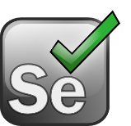




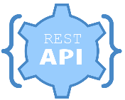





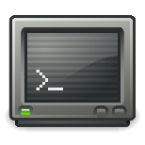
LTI Automation Testing Framework
Feature rich, highly configurable, and extensible framework to achieve E2E automation
Various ready to use utility functions to for faster scripting of Web UI, API, DB, Excel, reporting, ETL etc.
Open-source first approach reduces tooling cost. Has provision for integration with commercial tools
Supports E2E scripting with heterogeneous technologies in single script e.g. same flow can cut across different applications/ services containing API, Web UI, Desktop applications, Mainframe emulators and more.
Provides cleaner, re-usable scripting approach through Page Object Model (POM) inspired design pattern
Ready to use starter kit available for faster deployment [Framework, User Guides, Best Practices]
CI/ CD
Framework Benefits
Test Scripts
System Under Test
Supports BDD
HTML 5 reporting
Multi-day execution support
Parallel Execution for Web UI
Built-in error handling
Multi-env & language support
Integrated tooling
Cucumber
Selenium
REST Assured
Lean FT
Config and Error Handling
Reporting & Logging
Function Libraries
Object and Test Data
Lean FT – commercial tool – Licensing required
Notes:
Web UI :: Cucumber BDD Framework :: Supports feature file based automated script creation :: Cucumber, Selenium :: Open-source
API Automation :: Supports REST API automation using Java :: REST Assured :: Open-source
HTML Reporting :: Detailed HTML reporting with screenshots and dashboards :: Extent Reports :: Open-source
Mainframe and Desktop Automation :: Java based implementation to integrate with existing tooling :: Lean FT :: Commercial
Waterfall Automation :: To support test case automation (instead of feature files) :: Test NG :: Open-source
Kafka Automation :: To enable interaction with Kafka topics :: Java
FIX Protocol Automation :: To enable FIX message codes validation :: Java
ETL Functional Automation :: To validate functional ETL scenarios for flat file comparison :: Java
FXL :: Bespoke C# based automation framework :: Spec Flow, Selenium, REST Sharp and Visual Studio :: Added support for MS MQs

Slide 3
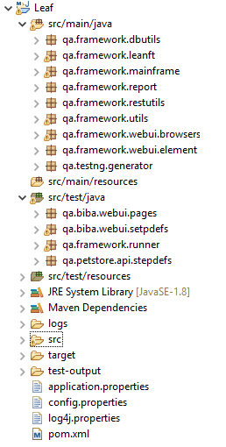


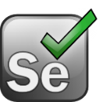



Framework Overview
User Stories
Feature files will be the base for automation scripting
Page Object Model (POM) inspired framework
UI: Page class contain all for respective pages
Step definitions are also maintained at page level
UI Object locators stored in database
API: Separate class is maintained for each API
UI test data stored in database, Feature File Data Table/ Examples
API request/ response data stored in JSON/ XML/ Excels
Utility functions for faster script development and easy maintenance
Hooks to handle pre and post test actions
Cucumber tags for creating test suites e.g. smoke, regression etc.
Comprehensive run results report using extent report
Built-in error handling via action classes and utility functions
Feature Files
Step Definitions
Scripting
Data Setup
Execution
Reporting

Slide 4

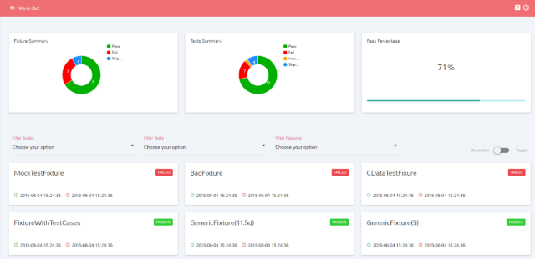
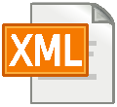


Framework Activity Flow
Run with select tags
Page1_StepDefs
------------------
------------------
------------------
class page1
public void method1
{
}
public void method2
{
}
Utility Classes
------------------
-- DB Utils
-- Excel Utils
-- Log Utils
-- File Utils
-- Web Actions
-- UI Actions
3
4
5
1
Feature: <>
Scenario: <>
Given <>
When <>
And <>
Then <>
And <>
Before Hook
Page2_StepDefs
------------------
------------------
------------------
class page2
public void method1
{
}
public void method2
{
}
Database
-- UI Objects
-- Test Data
2
After Hook
6
Page3_StepDefs
------------------
------------------
------------------
class page3
public void method1
{
}
public void method2
{
}
API Resources
-- JSON/XML (s)
-- Excel Data
Extent Report

Slide 5
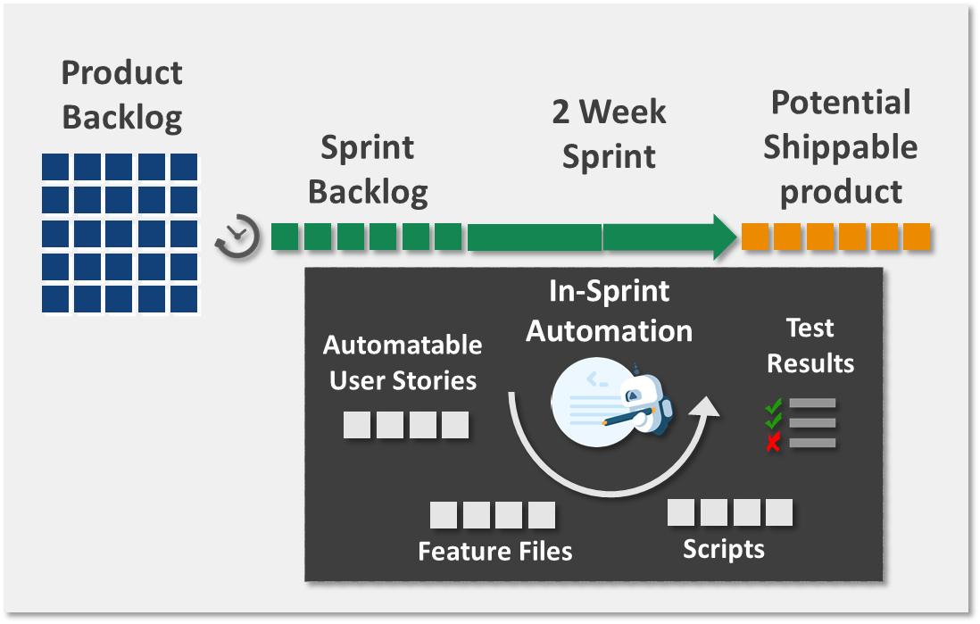


Major Wealth Management Product Company - Case Study
Implemented in 35+ independent agile projects across program with 60+ automation testers
Successfully delivered 20+ sprints and 4 major releases
Eliminated separate window for release regression through automation
In-sprint automation approach to eliminate initial round of manual testing
Optimized BDD approach to eliminate manual test case creation
Created Java and C# based variations of the framework
In-sprint automation achieved for 85% of agile projects
Implemented and Integrated Lean FT despite of technical challenges
JIRA utilities to save 70% effort of creating UBS extracts
Created ETL testing utility to save 80% effort
Optimized overall test processes and coached customer teams on quality gates
Achieved 70+ % test automation coverage for 90% of the agile projects

Slide 6
Test Suite Creation & Maintenance - Workflow
User Stories defined with clear Acceptance Criteria
Feature file is created with all scenarios
BA: Acceptance criteria clearly defined for all scenarios in-scope ?
Feasible to automate?
Candidate for Automation?
Yes
Validate Pre-requisites for Automation
Dev: Required test data, DB queries, REST URIs available for all scenarios ?
Critical functionality?
UI / API test ?
Dev: Wireframes with all required object properties (Name and ID) available?
No
Existing functionality ?
Yes
Identify and Update all impacted scripts
Mark for manual testing
No
Create automation scripts: API/ UI
Script Review &
Dry Run
Add Script to Smoke/ Regression suite
BA
QA
Dev
End: Test case Added to Suite
Right level and focus on Test automation
Leveraged by System and Agile teams
Notes:
Automation not feasible for:
CAPTCHA Scenarios
Usability and visual validations e.g. UI layouts and print
Hardware testing and interactions e.g. biometric scanner, card swiping, QR reading, Barcode reading
Multimedia – video clips etc.
UI Objects where no unique properties exists
Custom widgets may not supported by the tools
Complex integrations where data flows through many systems and some systems are not feasible to automate
Certain PDF validations
Do not automate for:
Tests which are run less than 5 times in entire lifecycle – Focus on most frequently used tests
Functionalities which are expected to change drastically in near future e.g. UI tests where UI is expected to change.
Good for:
Smoke Test
Regression Test
Static & Repetitive tests
Data driven tests

